Slide 1
Git & Github 101
An introduction to version control.

Slide 2
What is Git?
Git is a distributed version control system.
It allows for easy collaboration and versioning of projects.
It was created in 2005 by Linus Torvald for development on the Linux kernel.
Along with Subversion, Bazaar, and Mercurial, is one of the most popular versioning systems to date.

Slide 3
How does Git work?
Git is revolves around repositories. There are local repositories (on your computer) and remote repositories (on a host, like Github).
The repository holds an entire history of your project's revision.
In a general sense, a repository is a directory. That directory has files and folders (your code) and the .git directory.
You use Git through the command line (on Windows, Git Bash, on UNIX systems like Mac OS X and Ubuntu, you use Terminal)

Slide 4
Cloning local and remote repositories.
To get the code and history of a repository, you ﻿clone it.
git clone git://github.com/eturk/jack

Slide 5
See the history of a repository.
To see the entire "commit" history of a Git repository, you see the log of it.
(In a Git repository)
git log

Slide 6
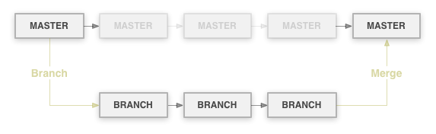
Branches and Merges
Branches are different copies of the same project.
You use git branch to see your current branch and git checkout [branch-name] to change branches.
Generally, you do all development in the master branch, then you merge into a stable branch when development is done.
To merge, checkout into the branch you want to merge to and use git merge [other-branch].

Slide 7
Committing yourself to something.
After you've made your changes, you commit the files to the local repository. Git notes the changes and records them.
You often add a message, so you'd do something like:
git commit -m "The changes I've made."

Slide 8
Push!
After committing changes, you have to push all of this information to the remote repository.
Running git push will to the default branch (usually master).
If you use git push origin [branch], it will push to [branch].

Slide 9
Example Workflow
git init
git add .
git commit -m 'Initial commit'
git remote add origin git@github.com:eturk/apcs.git
git push origin master
git add README
git rm RANDOM_FILE
git commit -m 'Added README, removed RANDOM_FILE'
git push origin master
git checkout stable
git merge master
git push origin stable

Slide 10
Best Practices
Commit Often
When writing a paper, you save often. The same applies to Git.
Pull Often
Get the latest code as quickly as possible!

Slide 11
Collaboration with Git
You're working on a project called HelloWorld with Joe & Bob.
Everyone has their own repository on their computer and hosted on the Internet.
Your online repository is the official repository. Joe and Bob's are for development (so when someone wants to use HelloWorld, they would get the code from your repository).

Slide 12
Collaboration with Git
Joe's making a new feature. He would work on it and push to his online (or "remote") repository.
When you're satisfied that it works, you'd incorporate it into the main repository by "pulling in" his code into a new branch on the remote repository.
You'd then merge the new branch into the main branch.
Then, Bob would run git pull on his computer's (or "local") repository to get the latest code.
Remember, commit and pull often!

Slide 13
git stash, to the rescue!
You've made changes in your local repository after someone's made changes to the remote repository
This'll cause a non-fast-forwarding error. Git doesn't know what to merge!
git stash can save us! Run git stash to save all of your changes (it'll revert you back to the last time you pulled).

Slide 14
git stash, to the rescue!
You can store more than one stash! Run git stash list to see all of the times you stashed.
Once you've pulled in the changes, run git stash apply to re-apply your changes.
It'll intelligently merge the changes you stashed with the changes you've pulled in.

Slide 15
Where to host?
You need a remote repository, or Git hosting, to collaborate effectively.
For the longest time, http://repo.or.cz/ has been the standard... until GitHub came along.

Slide 16

GitHub
Founded in 2008 by Chris Wanstrath, PJ Hyett and Tom Preston-Werner, it has grown to 1 million users and 2 million active repositories.
With a combination of speed and a great user interface, it is now the most popular code hosting site on the Web.

Slide 17
GitHub's Best Features
Browse code online with syntax highlighting.
View file history.
Blame and annotations (view who made changes when and where).
Online editor.
Git-powered Wikis.
Integrated issue tracking, with milestones, labels, search.
Code Review
Pull Request = Code + Issue + Comments
Comments (comment on commits, files, or even specific lines).
Network graph (shows all forks).
Compare view (see differences in commits)
Community
Watch repositories and users.
Profiles
Explore!

Slide 18

Who's on GitHub?
Linus Torvald and the Linux kernel
Twitter
Facebook
Rackspace
Yahoo!
Shopify
EMI
Six Apart
Sun/Oracle
Node.js
Apache

Slide 19
Setting up GitHub
Go to https://github.com/signup/free and signup.
You need to give your SSH key to GitHub, so go to Start, Git, Git Bash
Type ssh-keygen -t rsa -C "your_email@whatever.com"
When it asks you for a file to save to, just hit enter.
Enter a passphrase (twice), or else Very Bad Things™ will happen.
Open C:/Documents and Settings/.ssh/id_pub.rsa in Notepad.
Copy the contents exactly how they are.
Go to https://github.com/account/ssh and click "Add a Public Key"

Slide 20
Setting up GitHub (cont.)
Name it something descriptive, like "school".
Paste the contents of id_pub.rsa into the "Key" field.
Click "Add Key".
Test it out by running ssh -T git@github.com
It'll ask you to connect, type "yes" and hit enter.
Now it should say Hi, [username]! You've successfully authenticated, but Github does not allow shell access.
git config --global user.name "Your Name"
git config --global user.email "your@email.com"

Slide 21
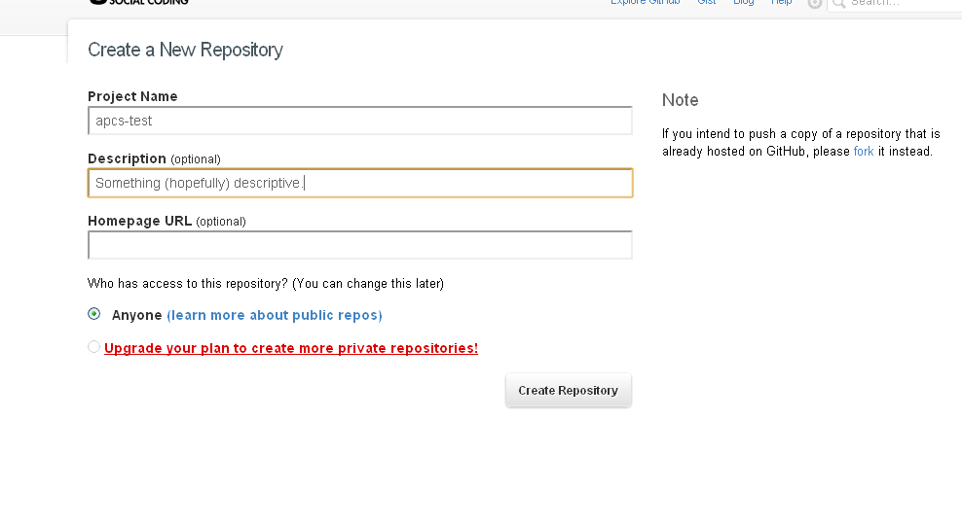
Create a new repository.
Go to your Dashboard and click "New Repository".
Enter a name and maybe a description, then click "Create Repository"

Slide 22
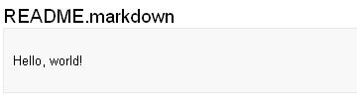
The Initial Push
Make a file called README.markdown
Add "Hello, world!".
git add README.markdown
git commit -m 'Initial commit.'
git push -u origin master

Slide 23
Forking and Cloning
To fork, go to any repository and click "Fork".
Now you have your own version of that repository.
Clone it, make some changes, and push.

Slide 24
How You Would Use Git & GitHub

